Slide 1


Slide 2


Github / PRs / Zenhub
Brendan Tierney

Slide 3

Notes:
GitHub
What PM Software have you used?

Slide 4

^{What are the}
Notes:
What are the benefits

Slide 5
Github
Code hosting (and sharing) platform
Collaborative sharing environment
Used for most Open Source projects around the world
Commonly used in most companies, enterprises, research, etc.
Active Github profile is very attractive to potential employers
Showcase your work
Teamwork
Tutorials - https://guides.github.com/activities/hello-world/
https://github.com/apps/github-learning-lab is a great resource too.
Git CheatSheet https://education.github.com/git-cheat-sheet-education.pdf
Lots of Resources available online

Slide 6
Git commands
git status – find out what files in your repo are not persisted
git add – attach a file to add to a local repo
git commit – save to your LOCAL git repository
git push – Push or save the changes to GitHub (Cloud)
git log – View the status of what was committed - NB. it contains your name, email address and what you added
Cheat sheet - https://github.github.com/training-kit/downloads/github-git-cheat-sheet.pdf

Slide 7
Git advice
Commit early and often
Useful as an audit trail
Make your commit messages meaningful

Slide 8
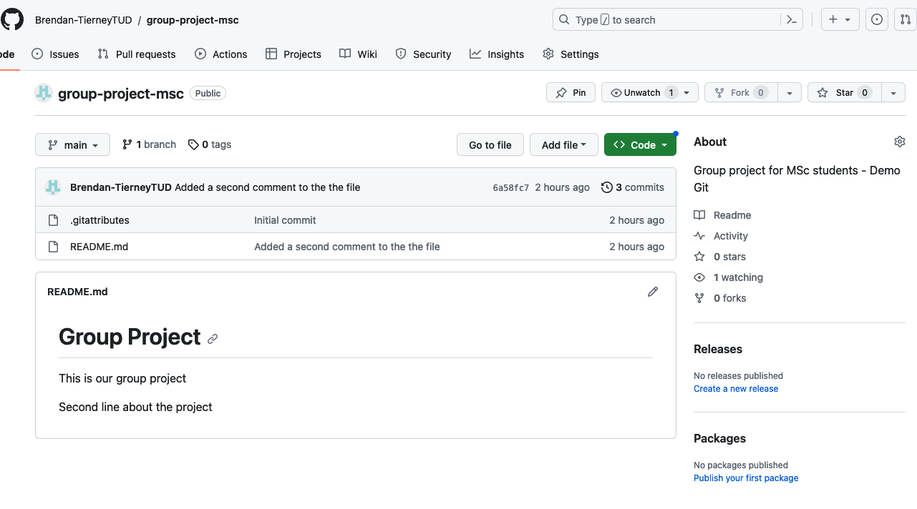
Git Website
Central Repository for all work and projects
Review changes, Branches, Pull-Requests, Comments
Request Code (Document Reviews)
Discuss, approve changes
Collabative Environment
Pull-Requests
Issues
Wiki
Various Plug-ins

Slide 9
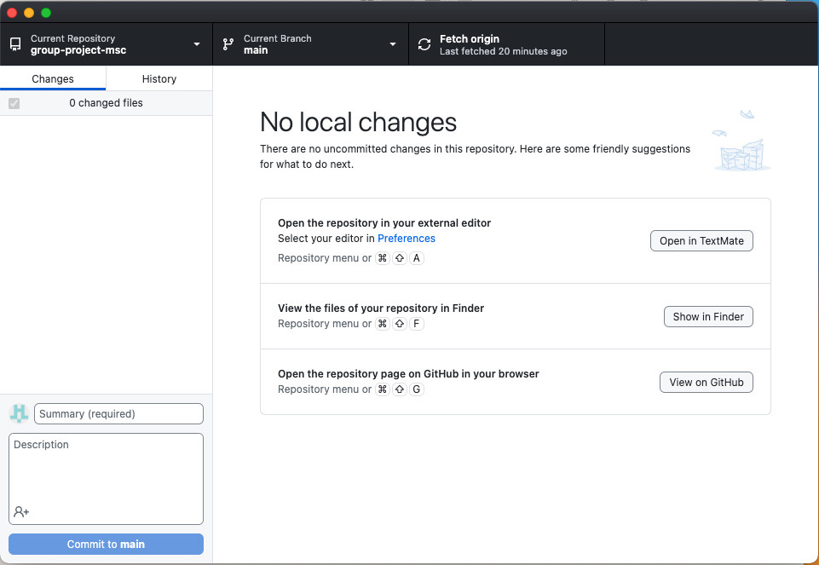
Github Desktop
Lots of tools to use with git: git cli, Source Tree
Lots of Developer Tools, IDE, etc have Git features
Desktop is a great free tool.
Clone
Setup new
Branch
Pull
Push
etc
Easy to install, just follow installation instructions.
Easy to swap between command line Git instruction and GUI

Slide 10
Pull Requests / Reviews
Master is ‘god’ – never commit directly to master
Create a Branch. Work on it and when ready Merge to Master/Main
PRs - tell others about changes you’ve made in a repository
Always work from a branch and ‘merge’ to master once approved
4 eye principle – 4 better than 2
https://dev.to/codemouse92/10-principles-of-a-good-code-review-2eg

Slide 11
Github Education Pack
Github has an education pack that provide enterprise level offerings free for students.
Excellent, excellent free training on most topics
Sign up to avail https://education.github.com/pack
Should use full name (and match to what’s on your Student Card/ID)
Use your Student Email
Maybe picture of Student Card
Can take a day (or two) to be approved

Slide 12
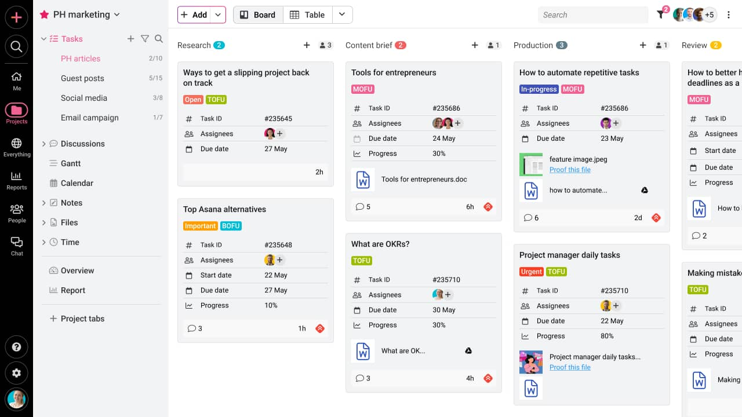


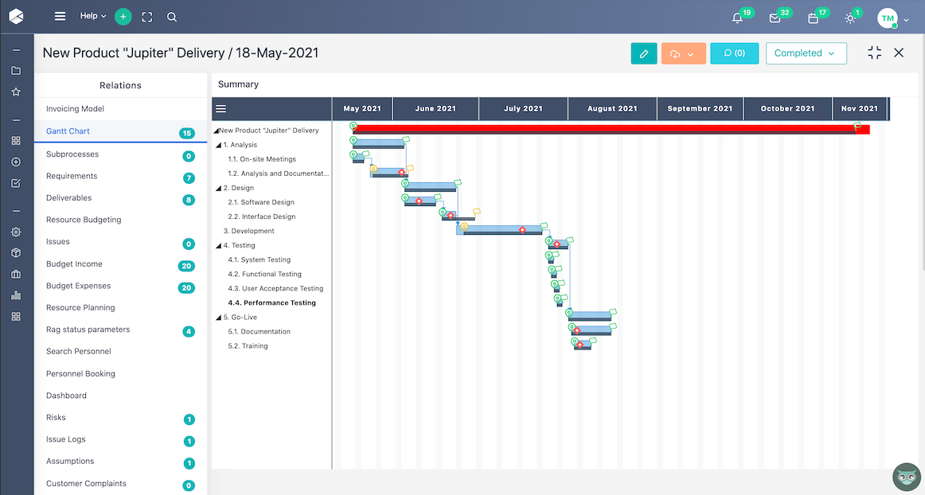
Notes:
What PM software have you used?

Slide 13
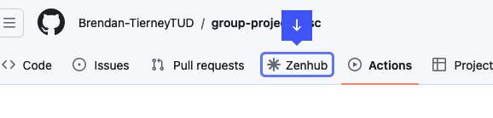
Zenhub
ZenHub is the only ‘free’ project management tool that integrates natively within GitHub’s user interface
https://www.zenhub.com/
Google Zenhub chrome extension.
If using Firefox – google zenhub firefox extension
Follow install instructions, sign-in using Github account, follow instructions, open up github repository

Slide 14
Zenhub
Follow installation instructions
Open Repository and click on Zenhub tab
Follow instructions, give your workspace a name

Slide 15
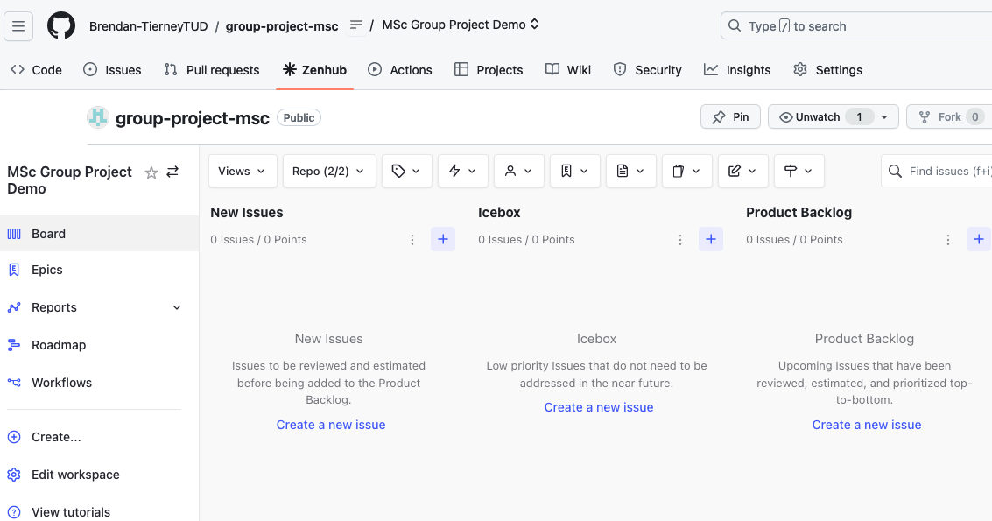
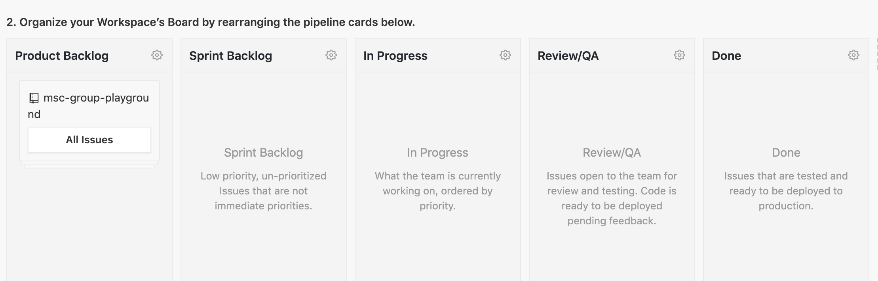
Zenhub
Set up workspace like below and click ‘Complete Board Setup’

Slide 16
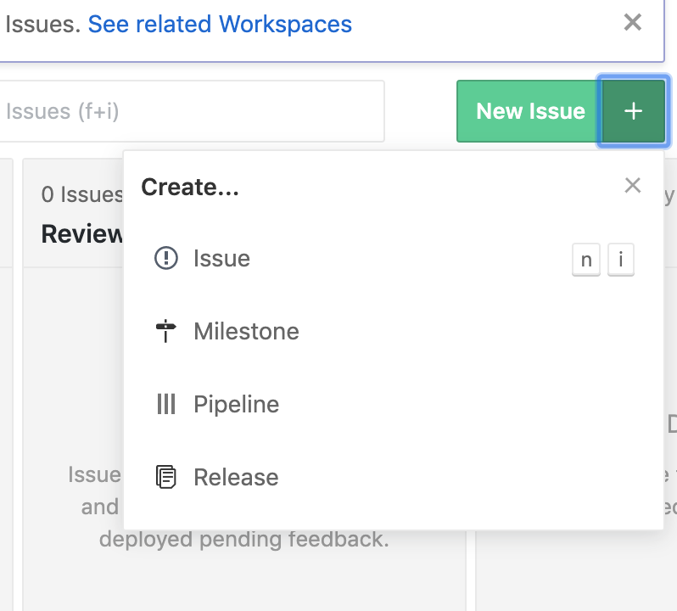
Zenhub - Milestone
Create an Milestone by clicking below:
Fill in start and end dates and give a title ‘Sprint 1’

Slide 17
Zenhub - Epics
Create an Epic by clicking green ‘New Issue’ on top right of board
Fill out details, and select newly created Milestone
Click ‘Create an Epic’

Slide 18
Zenhub - Stories
We break down Epic stories into lots of smaller stories.
Create a story by clicking green ‘New Issue’ on top right of board
Fill out details, and select newly created Milestone and Epic.
Estimate this, how?

Slide 19
Zenhub - Estimation
Try and size stories relative to each other
Might need a spike if you cannot estimate
Points | Effort
1 | No sweat < 4 hours
2 | Again, no sweat 4-8 hours
3 | Nothing we can’t handle, between 1-2 days
5 | This is going to take some effort, circa 3 days
8 | Too big, should really break down further

Slide 20
Zenhub – Repeat
Repeat this process till you think you can fill sprint
This is your commitment to yourselves and your product owner
You can bring more in from backlog

Slide 21
Zenhub – Useful Links
2 ½ min videos
ZenHub How-To: Project Management Inside GitHub https://www.youtube.com/watch?v=TRu7vKCg920
Using ZenHub Issues, Milestones, and Epics https://www.youtube.com/watch?v=tJ375ju3xTc
Zenhub – Sprint Planning - https://www.youtube.com/watch?v=S_yzDz3rHCI

Slide 22
Homework - 1
Create a GitHub account if you do not already have one.
If you already have one – ensure it’s your actual real full name (not a nickname)
Each team, get together and create a single repository for the entire team.
This will live in one person’s GitHub account. - Make sure repo is Public.
You MUST add all the team members as collaborators on the team.
Email me (brendan.tierney@tubulin.ie) with link to Github
EACH team member must make a contribution to the repository via a Pull Request (PR).
Every team member creates a file ‘student number’.md and create a pull request and share the Pull Request with your team (MS teams) for approval. i.e. d34344123.md. Content in file can be ‘hello world, my name is …’
I will review to ensure everyone has created a PR prior to next weeks meeting
Deadline - Complete by Wednesday before 23:00
We will be reviewing all Github activity for each Team, every week. [every Thursday at 09:00]

Slide 23
Every Week
Your contributions to the Project Github will be evaluated each week.
This will not be at Team level -- at individual level within Team
Everyone needs to contribute – no just one or two
It will be at the Individual level.
You need to contributing in various ways – code, reviews, comments, etc.
Demonstrate lots of activity
On a Regular basis throughout each week - and not just once or twice
Do not do – lots of contributions just before the deadline
I’ll be reviewing your activities each week.
Every Thursday at 09:00

Slide 24
Homework - 2
Decide what Project Management Software the team will use.
Make sure it is viewable by others (Andrea, Damian and myself)
Create an initial Project Plan
Allocated Tasks, Estimate of Effort, etc for the first 3-4 weeks
Decide who is the Team Lead for Week-1, Week-2 and Week-3
Everyone to take turns at Leading the Team
They are in charge for that week
Deadline - Complete by Wednesday before 23:00
Share link to PM software/plans etc with each of the Metors

